Slide 1
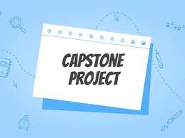
Orange HRM Automation Demo – Playwright with C#
Team-
Noel Buxton
Sneha Pitambare
Mohit Ahuja

Slide 2
Our Team
Noel Buxton
Sneha Pitambare
Lead, Coding, Framework
Admin Module
Coding, Demo, Presentation
Claims Module
Mohit Ahuja
Coding, Demo
PIM Module

Slide 3
Agenda
Application Overview
Tools & Technology Overview
Framework Overview
Strategy, Progress & ROI
Best Practices Followed for Automation
Demo
Challenges
Key Takeaways

Slide 4



Orange HRM Application Overview
OrangeHRM offers a comprehensive HR management system to suit all of business HR needs which can also be customized according to organization requirements. The admin team at Orange HRM is very responsive which makes the customer experience a great one. Intuitive, simple to use and effective for managing the "people basics" of the organization
For Test Automation we focused on below key areas
Sanity Checks on all the modules
People Management
Admin
Employee Claims

Slide 5


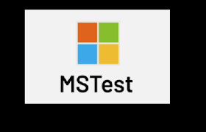

Tools & Technology
Playwright is Node.js library for Frontend UI Automation
C# is the language used for coding
MSTest – Testing framework
Visual Studio 2022 – IDE (source code editor)

Slide 6
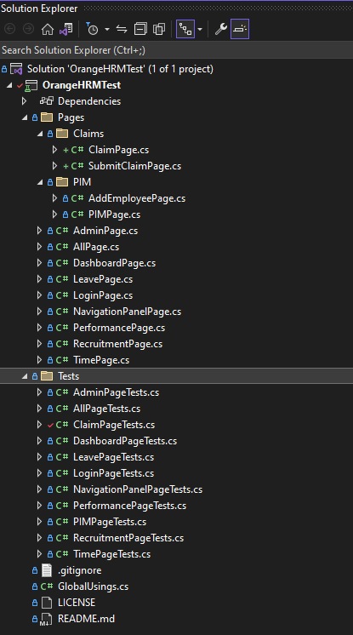


Framework Overview: Page Object Model (POM)
Page Object Model (POM) framework is implemented. This helped us to increase test maintainability and reusability by organizing tests into modular page objects.
PAGE OBJECTS
UI Elements
TASKS
Common Methods
TEST CASES
Test scripts are created by using Tasks
Utilized by methods in task level
Utilized by Test Scripts
Contains TestInitialize and TestCleanUp Methods

Slide 7
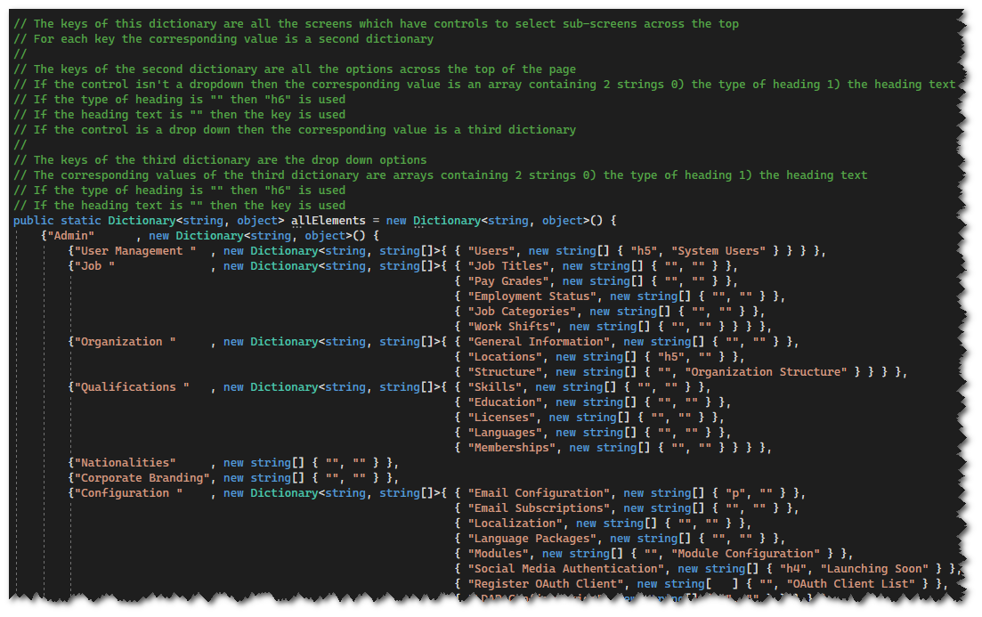
Framework Overview (Cntd.)
Automated Sanity Tests to validate modules on multiple levels:
Implemented Data Dictionary to validate each tab on navigation pane, For eg: Admin, PIM, Leave etc.
Validated the sub tabs within the main screen, for example within Admin screen, validated User Management, Job, Organization etc.
Validated the heading of the screen as well.
This automation approach ensured reusability and efficient use of collections such as Arrays and Dictionary.

Slide 8



Strategy, Progress and ROI

Slide 9
Best Practices Followed for Automation
Implemented data driven tests to avoid repetitive tests
Designed scalable, maintainable and robust automation framework
Used Page Object Model design pattern for reusability

Slide 10
DEMO

Slide 11

Learning Curve of team - This was the first automation project taken up by the team, so time was required to understand the application and technical aspects of it
Insufficient time due to delivery projects - Automation requires dedicated time to develop robust and efficient framework to scale for the future. As each team member is assigned to their respective projects, this initiative required us to stretch our time.
Security configuration due to Zscaler - "Error: unable to get local issuer certificate" was blocking the team members when playwright browser installation was required
The application is test website so the data gets cleared every hour which means that any tests we create needed to be self contained.
Challenges

Slide 12

Key Take Aways
Team Collaboration: Helped us understand how to work in a team in an agile environment as an SDET
Code Review : Peer review helped us as a team to keep track of all the changes being done by the team and ensure best practices are followed
Branch Management in GIT: Understood how to manage branches in GIT and ensure minimal merge conflicts
Tooling and coding standards: In depth understanding of coding standards to be followed while working on automation and gained playwright with C# knowledge

